Slide 1
Twitter Recommendations
Finding New Followers Through NLP and Unsupervised Learning
Avery Peterson July 12, 2022

Slide 2
Objectives
Key Objective
Build a Twitter follower recommendation system
Recommends new users to follow based on Twitter activity
Why It Matters
Improves user experience & engagement through Twitter account discovery
Allows new users to find online communities centered around their interests

Slide 3
Targeting 2nd Degree Users
Avery
Primary User
John
Henry
Alex
1st Degree Following
(accounts I follow)
Kathy
Satoshi
Jeffery
Balajis
Joshua
2nd Degree Following
(accounts my following follows)
Target for Recommendation System

Slide 4
Data Statistics
Used Twitter’s Developer API Tweepy
19,759 Tweets from 106 Twitter Accounts
Tweets, Retweets, and Likes
API Limitations
Scraping limits — took 2 days to download 20k tweets
Maximum 7 days worth of Twitter history per user

Slide 5
Topic Modeling
Used NLTK for text preprocessing, cleaning, and parts-of-speech tagging (to eliminate stop words)
Used Scikit Learn for term vectorization and topic modeling (for dimensionality reduction)
CountVectorizer and TF-IDF for term vectorization
LSA, NMF, and LDA for topic modeling algorithms

Slide 6
Topic Modeling
Personal Account
Used LSA with CountVectorizer for topic modeling of my personal account
Used to find the best overall topic model for the rest of my data set
My Top 3 Twitter Topics for Personal Account
Crypto / Economics (world, digital, physical, money, ethereum)
Morality (age, yrs, life, total, human)
Philosophy (total, denial, good, evil, freedom)

Slide 7
Topic Modeling
2nd Degree Accounts
Chose Non-Negative Matrix Factorization (NMF) with TF-IDF vectorizer for final analysis
Top 3 Twitter Topics
General
Crypto
Sneakers
Russia / Ukraine *
* Excluded models with this topic
as this did not match personal
accounts topics

Slide 8
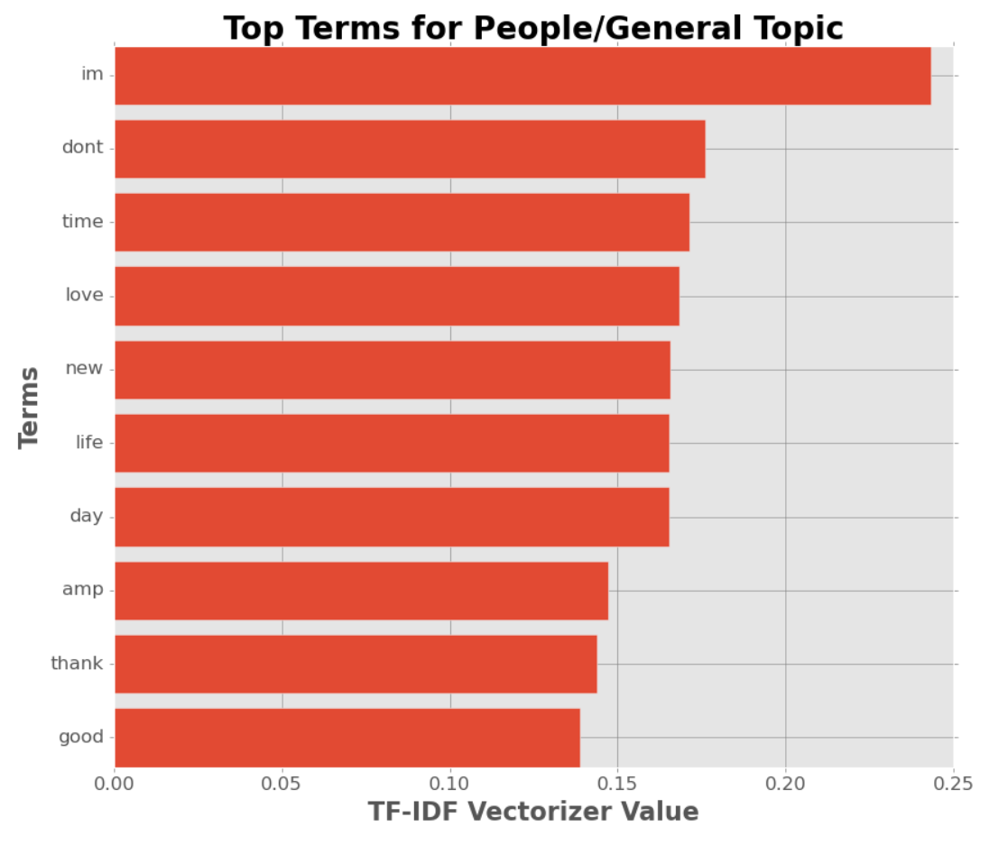
Topic Modeling
General Top Terms
I’m
Don’t
Time
Love
New
Life
Day
Amp
Thank
Good

Slide 9
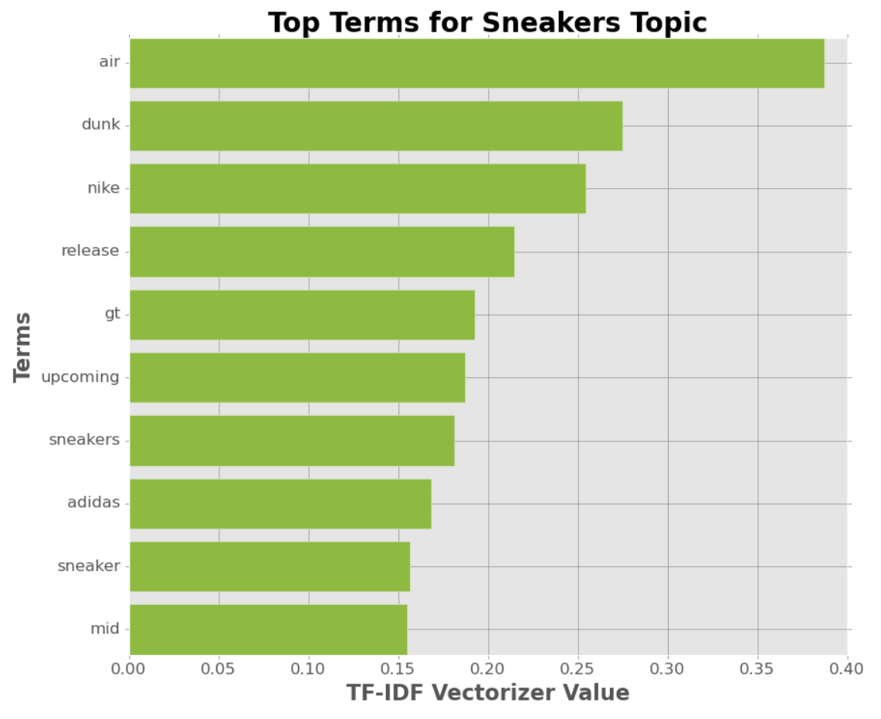
Topic Modeling
Sneakers Top Terms
Air
Dunk
Nike
Release
Gt
Upcoming
Sneakers
Adidas
Sneaker
Mid

Slide 10
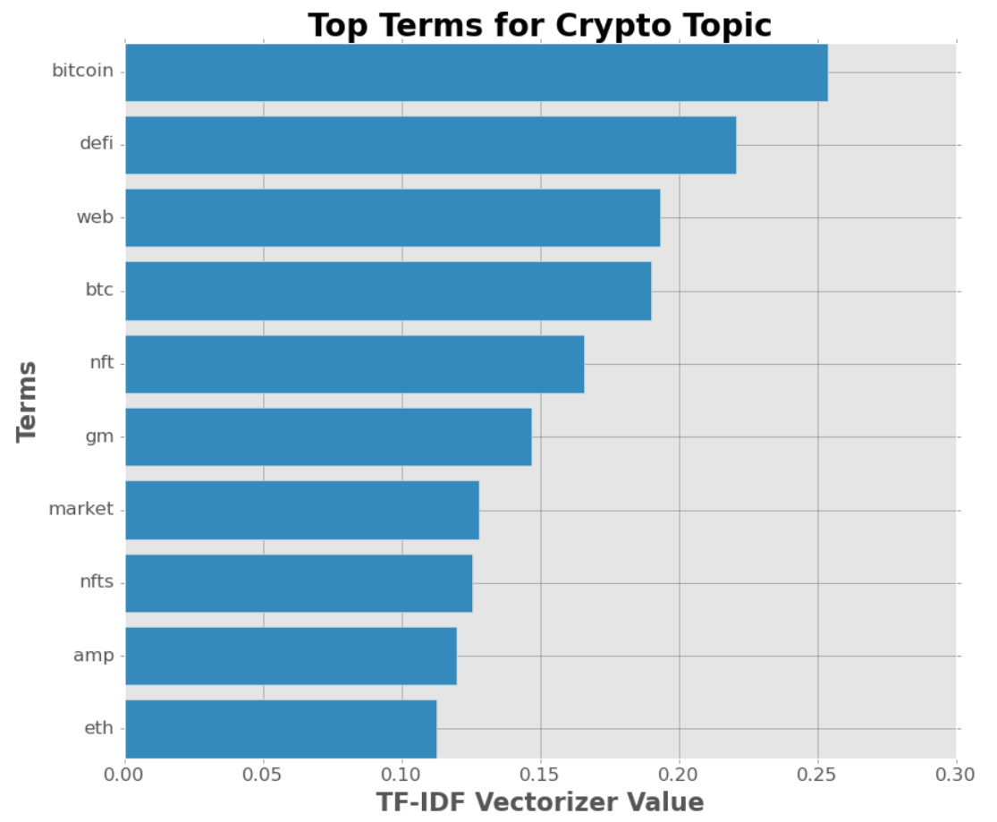
Topic Modeling
Crypto Top Terms
Bitcoin
DeFi
Web
BTC
NFT
gm
Market
NFTs
Amp
ETH

Slide 11
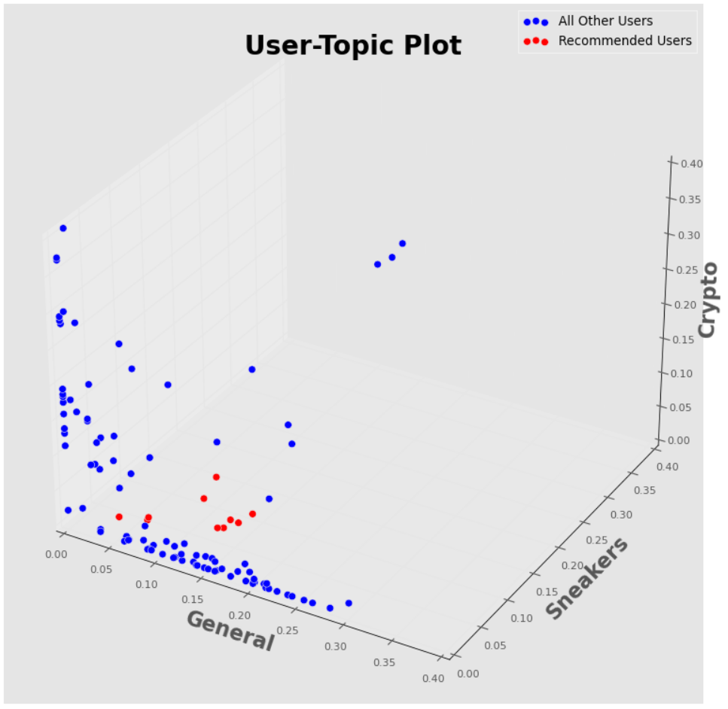
Recommendations System
Using Cosine Similarity
For each user, their topic values represent a 3-dimensional point
EX: (General, Sneaker, Crypto)
For each user, I calculated the cosine similarity with my account’s topic score
My Score: (0.181, 0.102, 0.117)
Recommended
Users

Slide 12
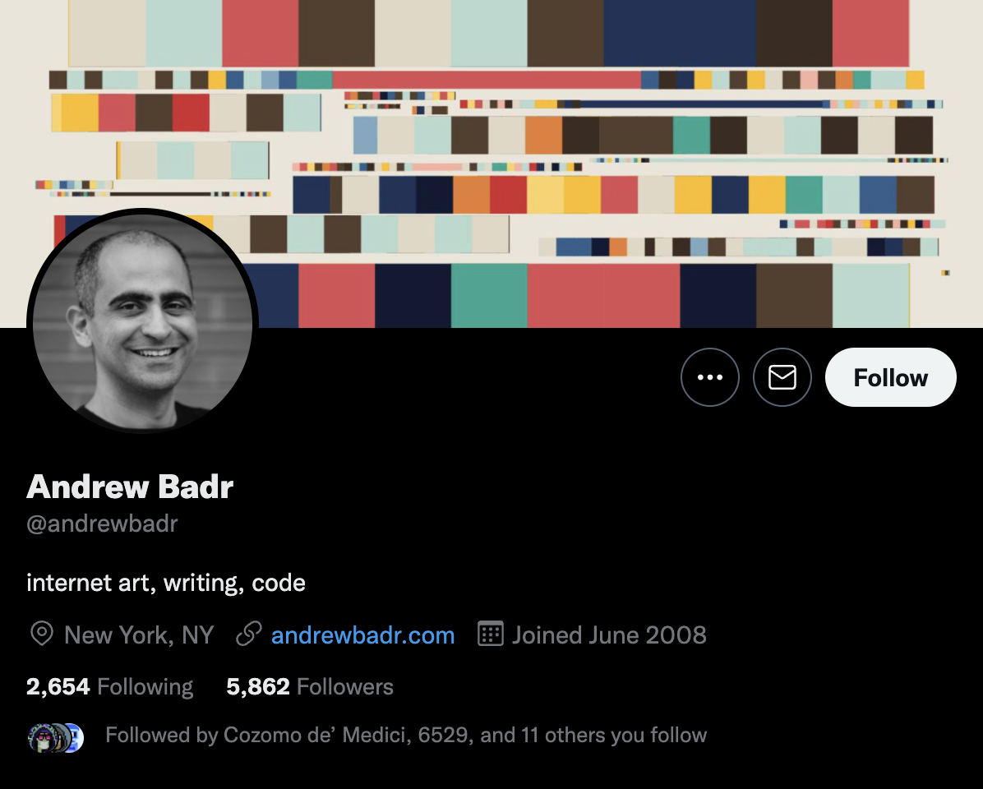
Final Recommendations
Andrew Badr
Writer and programmer
Blogs about NFT’s, digital art, and Web3
Tweets about programming and art within the NFT space

Slide 13
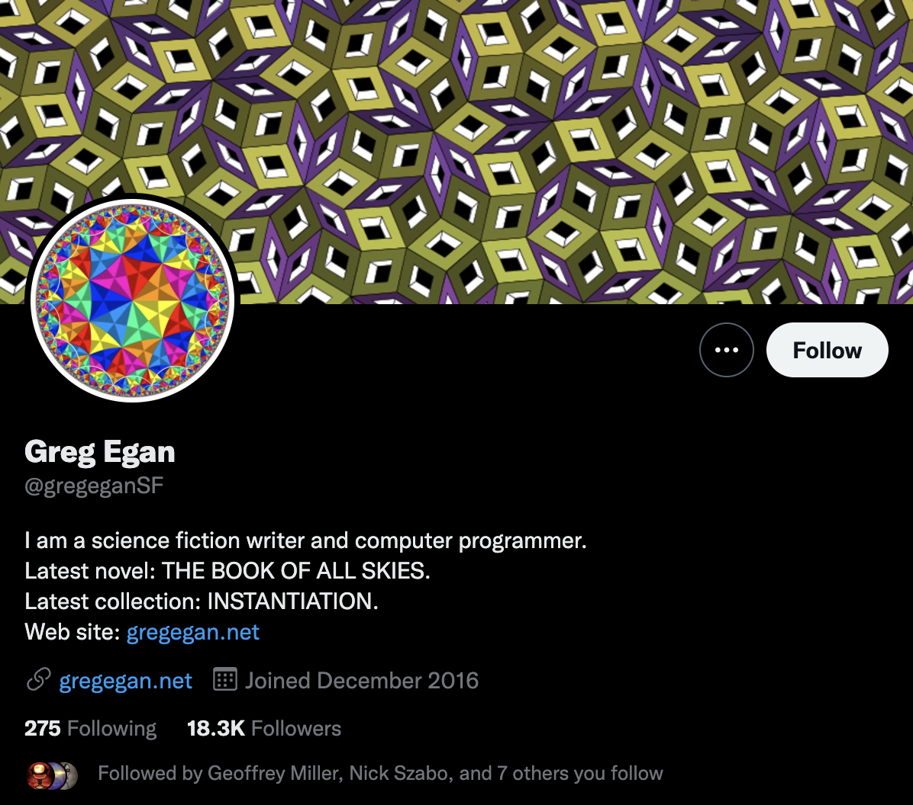
Final Recommendations
Greg Egan
Science fiction writer and computer programmer
Tweets about cryptocurrency and philosophy
Also tweets about science and physics

Slide 14
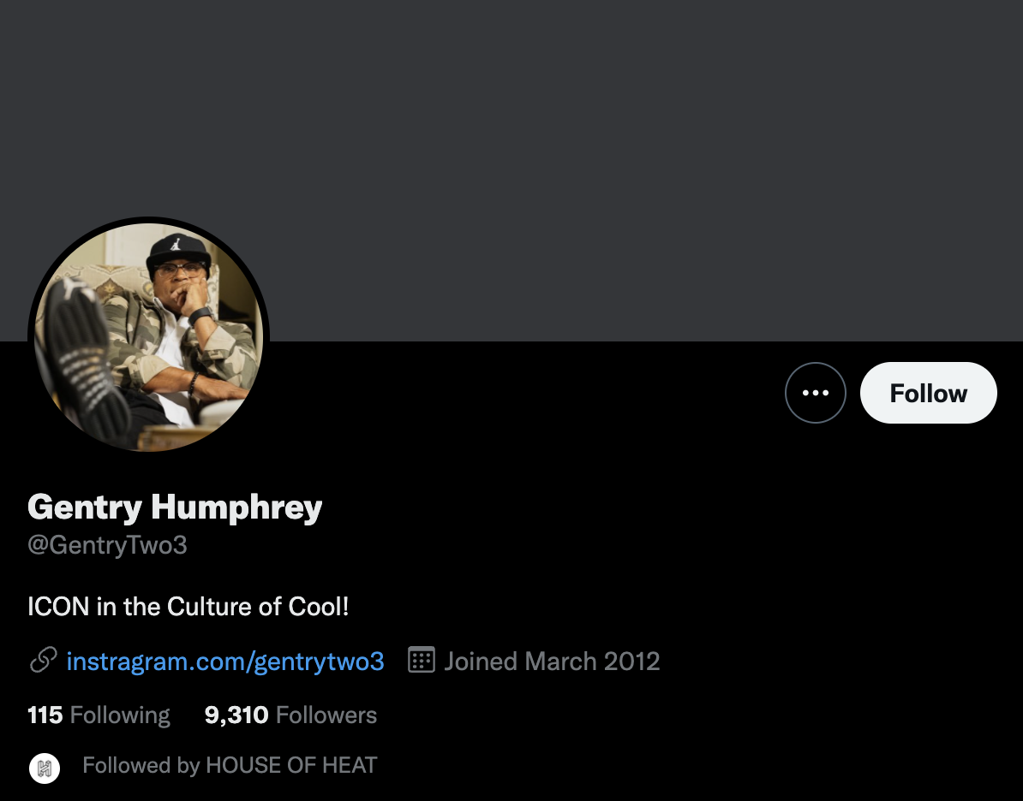
Final Recommendations
Gentry Humphrey
A former VP of Nike Footwear who worked there for 20+ years
Was essential to the prolonged popularity of Jordan Brand
Tweets about sneaker culture, basketball, and style

Slide 15
Future of Work
More tweets and more users
Apply recommendation model to other users
Randomly select 2nd degree followers (vs. the 100 most recently followed)

Slide 16
Questions?

